Slide 1
Presentation on environment

Slide 3
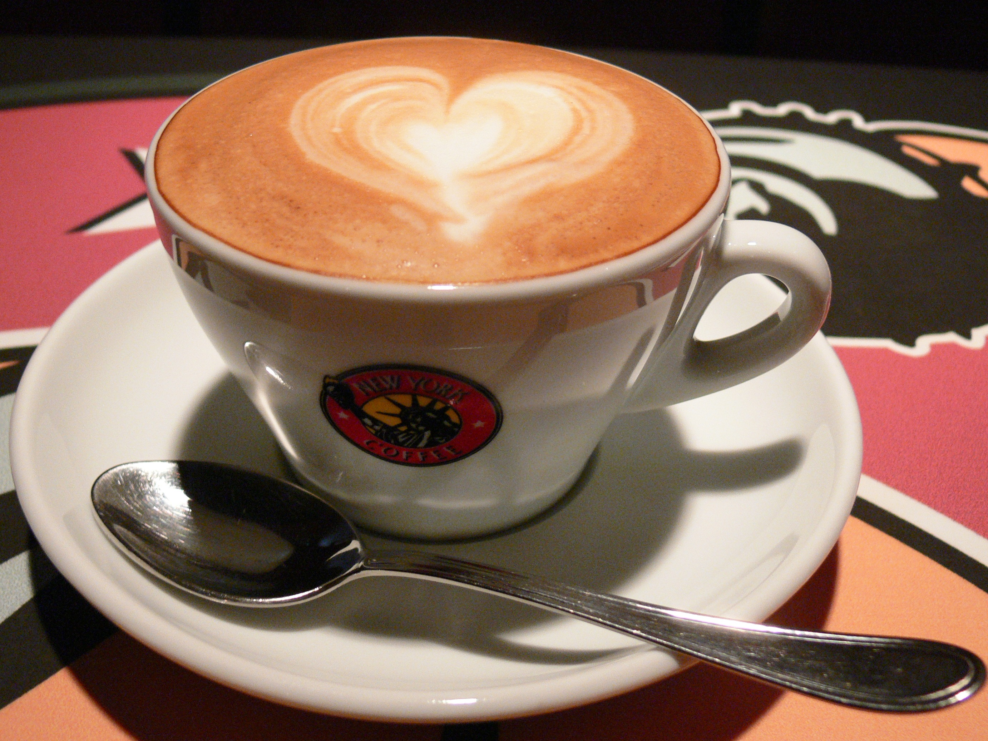
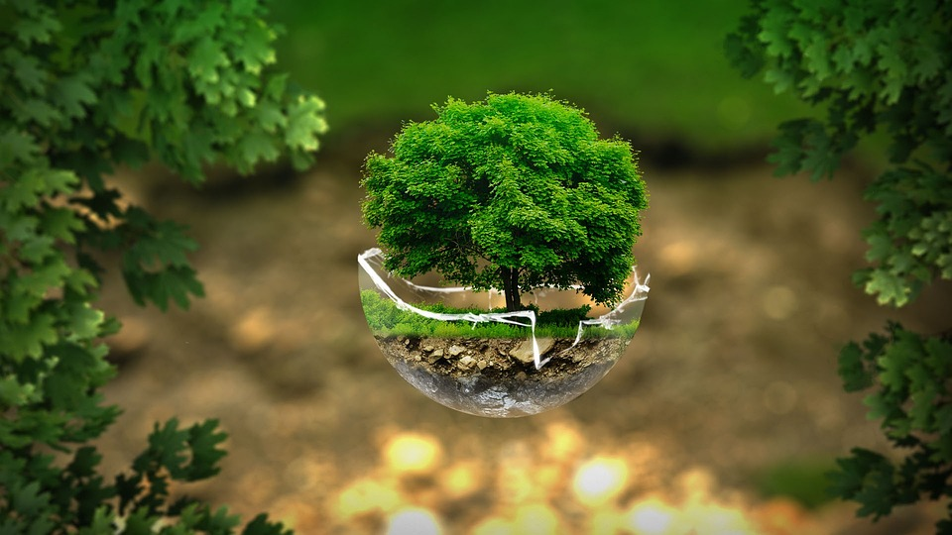
Save tree!
This Photo by Unknown Author is licensed under CC BY-SA

Slide 4
Group member :4
Tree are the base of the living oraganism
We should save the tree from cutting
They give us shade,fruit etc.
Because of trees rainy seasone come and enjoy

Slide 5
Thank you! See you at tomorrow till then keep learning keep explporing

